Slide 1
Introduction to Modular Programming
Jake Marshall
Trainee Data Science Lecturer
Notes:
This session will be a brief reminder of the days and intro to Modular Programming concepts.

Slide 2
What is Modular Programming?
Breaking larger programme into smaller, isolated modules.
Approach improves maintainability, flexibility and development time.
Modules can be developed independently and reused.

Slide 3

Benefits of Modular Programming
Easier to Understand
Flexible structure
Faster development
Reusable code
Maintainable
Notes:
Easier to understand – caveat that it is more complex up front sometimes to think and code in this way, but in terms of the splitting of code, it is more readable.

Slide 4

Why should we structure code?
Time consuming to implement but saves in the long run.
Crucial work with thousands of lines of code becomes impossible to maintain:
Debugging is a nightmare.
New functionality implies extensive re-write.
Notes:
If we are wasting multiple minutes scrolling through code to find elements we need to tweak or update, it becomes frustrating fast!

Slide 5
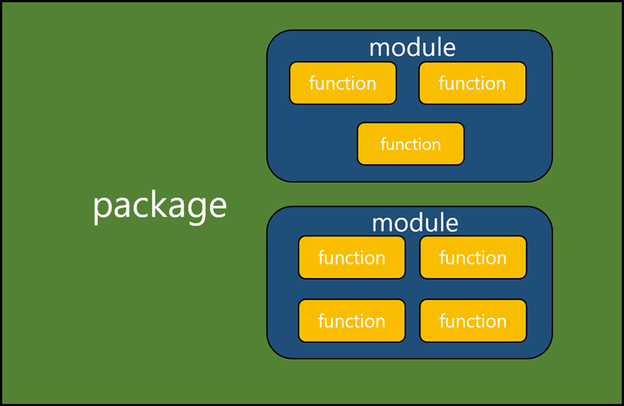
Components of structured code
A package (such as pandas, dpylr) contains modules of code.
Each module contains many functions, known as units of code.
Each function contains a task written in code.

Slide 6
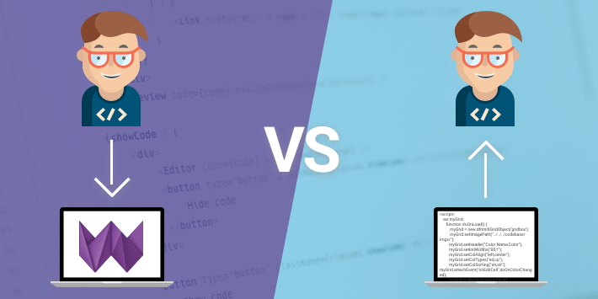
Basic Programs
Long scripts and notebooks are excellent for quick analysis and exploration.
They can limit how we scale and improve projects over time.
Imperative Programming – Telling our code how to do something.
Notes:
Declarative code on the other hand (which we work towards here)

Slide 7
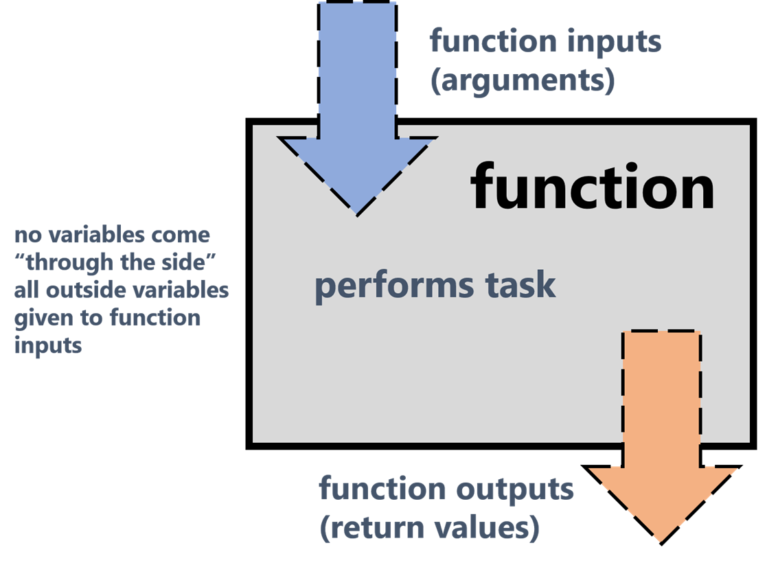
Grouping Code
Related code should be grouped into one object – particularly functions.
Functions take numerous input(s), perform some task and generate output(s).
Functions can be run in one line, hiding underlying code from the user.
Notes:
Classes are also an example (particularly for python) but are less prevalent in R which is a functional programming language.
If we name our functions well, the underlying details don’t matter, which assists with readability and interpretability.
Hiding underlying code is known as extraction.

Slide 8
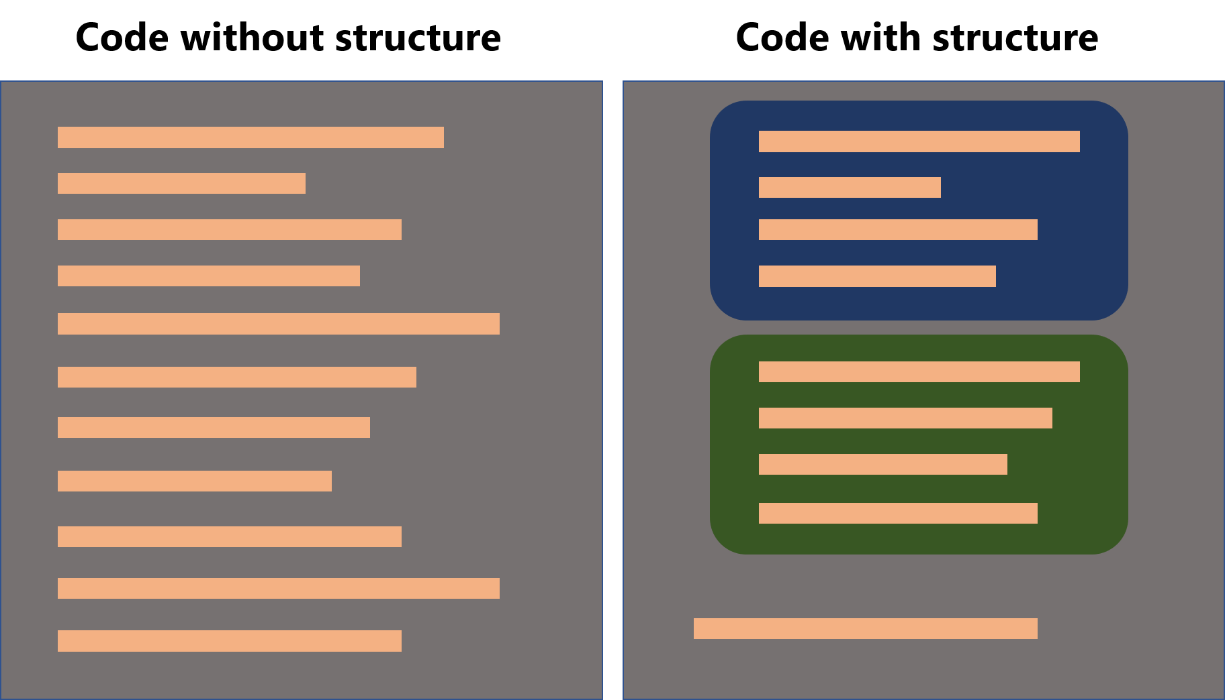
Structure vs. No Structure
Notes:
Code written without structure tends to include everything you want to happen in sequence without thought of putting similar/repetitive code together.
The process of modularisation has a few key “phases” that encompass the work. The first is writing or being provided with (for translation) the unstructured code.

Slide 9
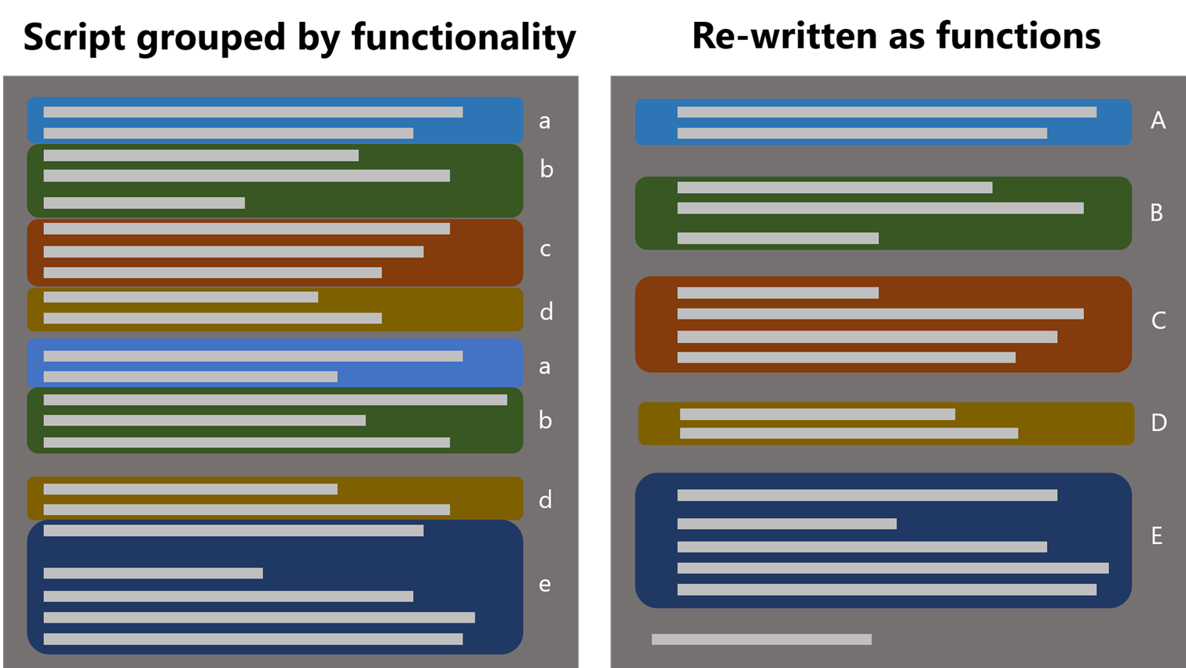
Scripts to Functions
Iterative process – difficult to think in a declarative mindset.
Group the code by functionality – repeated tasks such as analysis.
Groups should be generalised as reusable functions - refactoring.
Notes:
Grouping by functionality is quite challenging, as some data scientists may vie some tasks as analysis and others not

Slide 10

Scripts to Functions - Tips
Functions should perform one task – difficult to maintain otherwise.
Identify repeated tasks – cleaning, manipulation, read and write.
Identify generic housekeeping tasks – generalisable across projects, known as helper functions.

Slide 11
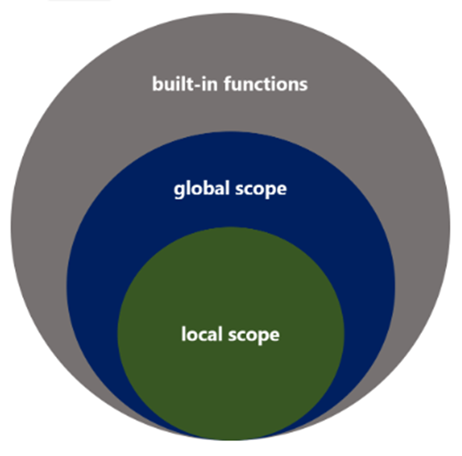
Scope
Where variables can be accessed in a program.
Variables created in scripts can be accessed in all locations – the global scope.
Variables created within specific objects, such as functions – the local scope.
Notes:
Underneath the hood, the variables assigned within the local scope of functions are arbitrary – based on personal preference and are just deleted and cleaned up after the function has run.
Scope is important when writing modular code. Everything inside a function is considered to have local scope, everything outside global scope.
This means that variables created within a function do not exist in the global scope, and as such if we tried to call them would be faced with an error.
We can, however, use objects from the global scope in a function. HOWEVER, just because we can, doesn’t mean we should do so without thought as to HOW they are used.

Slide 12

Scope Considerations
Variables with local scope do not exist globally.
Calling them outside of a function results in error.
Improper use of external variables locally is very bad practice:
Unintentionally modifying global variables affects all areas of a program.
If global variables are undefined, the script will fail.
Notes:
Variables assigned within the local scope a function are arbitrary - based on preference and are deleted and cleaned up after it is run.

Slide 13

Scope - Tips
Variables should be passed as arguments to a function or created within them.
If we must access local variables, they must be returned by the function and assigned globally.
Think of functions as having an entrance and an exit with no windows for access!

Slide 14

Functions to Modules
Well-structured code is better but still difficult to maintain.
We should group related functions together into separate files:
These must be imported as modules within Python (just like pandas).
OR sourced into R with the source() function.

Slide 15
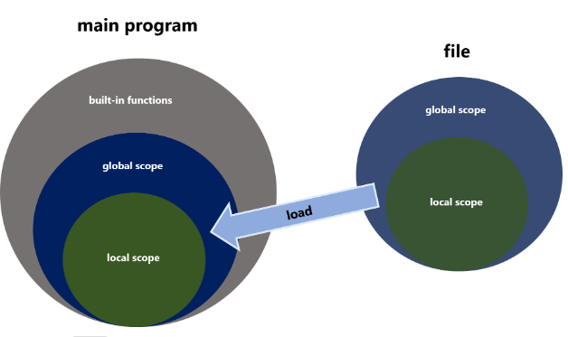
Separation of files
Generally, we have a main script that just runs the functions in sequence:
Or a higher-level function wraps those into one call – lessens interaction with users.
Importing/sourcing loads the functions and code into the global scope.
Notes:
In Python this is almost identical to importing packages, but in R it differs. Namely that loading in packages just loads in the library of code, whereas sourcing runs every line and creates each unnecessary variable, passing them to the global scope.

Slide 16

Any Questions?

